Slide 2
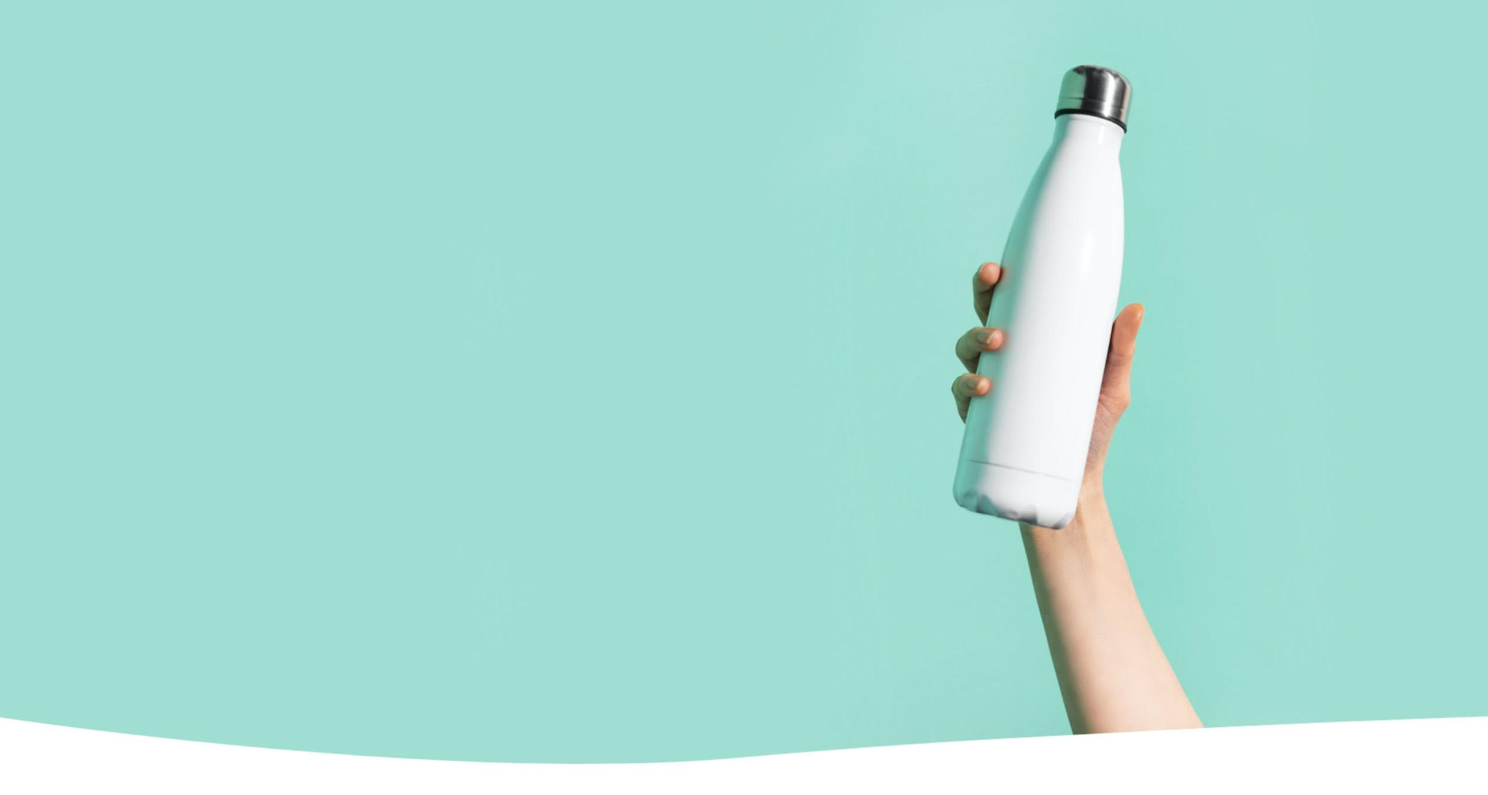
Bevi is building a bottle-free supply chain for beverages.
Our customers have saved over 500 million bottles and cans through machines that offer high-quality still, sparkling, flavored, and enhanced water on-demand.
Notes:
Equates to over 22 billion grams of CO2, 1.4 trillion ounces of oil, and 105 million ounces of plastic

Slide 3
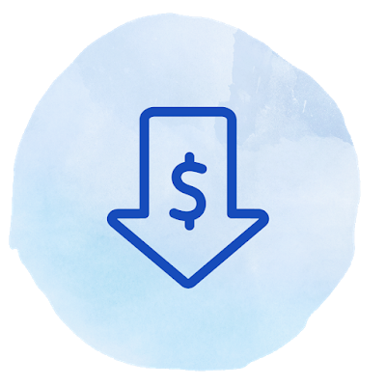
Benefits to commercial customers
An amenity everyone loves Water that delivers personalized flavor, well-being, and fun times in every pour.
Unbottle the future Reduce your carbon footprint–every Bevi machine can save 50,000+ bottles and cans per year. Boost wellness Quality ingredients that keep you hydrated without compromise. Cut your costs Our customers typically pay less than half the cost of canned and bottled water. Smart technology for smart hydration Keep the fun flowing without interruption with fresh on-screen content, seamless updates, and remote diagnostics.

Slide 4
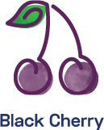
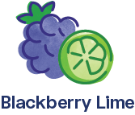
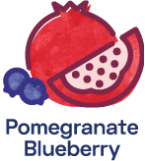
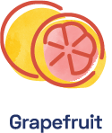
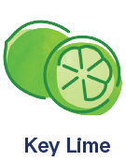
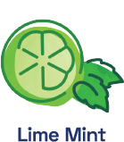
Meet Our Flavor & Enhancements
An array of flavors that are sure the make your guests smile. Choose a classic or mix flavors together for their favorite water yet.
Flavors made from real fruit essence – none of that fake stuff, ever!
Zero- and low-calorie flavors for guilt-free enjoyment
Our flavors are non-GMO, gluten-free, and vegan
Need a boost? Add an enhancement like Vitamin Boost, Caffeine, or Electrolytes.
Notes:
Opener slide with logo/wordmark, title

Slide 5
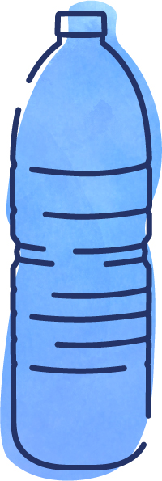
Proven Satisfaction with Hotel Properties
Bevi has partnered with the San Ramon Marriott, an HEI property, since 2019.
3 Standup machines located throughout the enjoyment among guests and staff
Club lounge
Guestroom floor by ice machines
Employee cafeteria
450+
Bottles
Saved
Also used by:

Slide 6
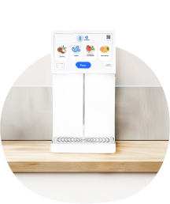
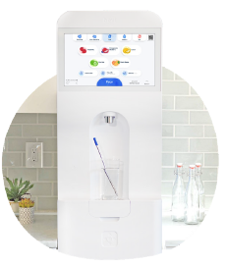
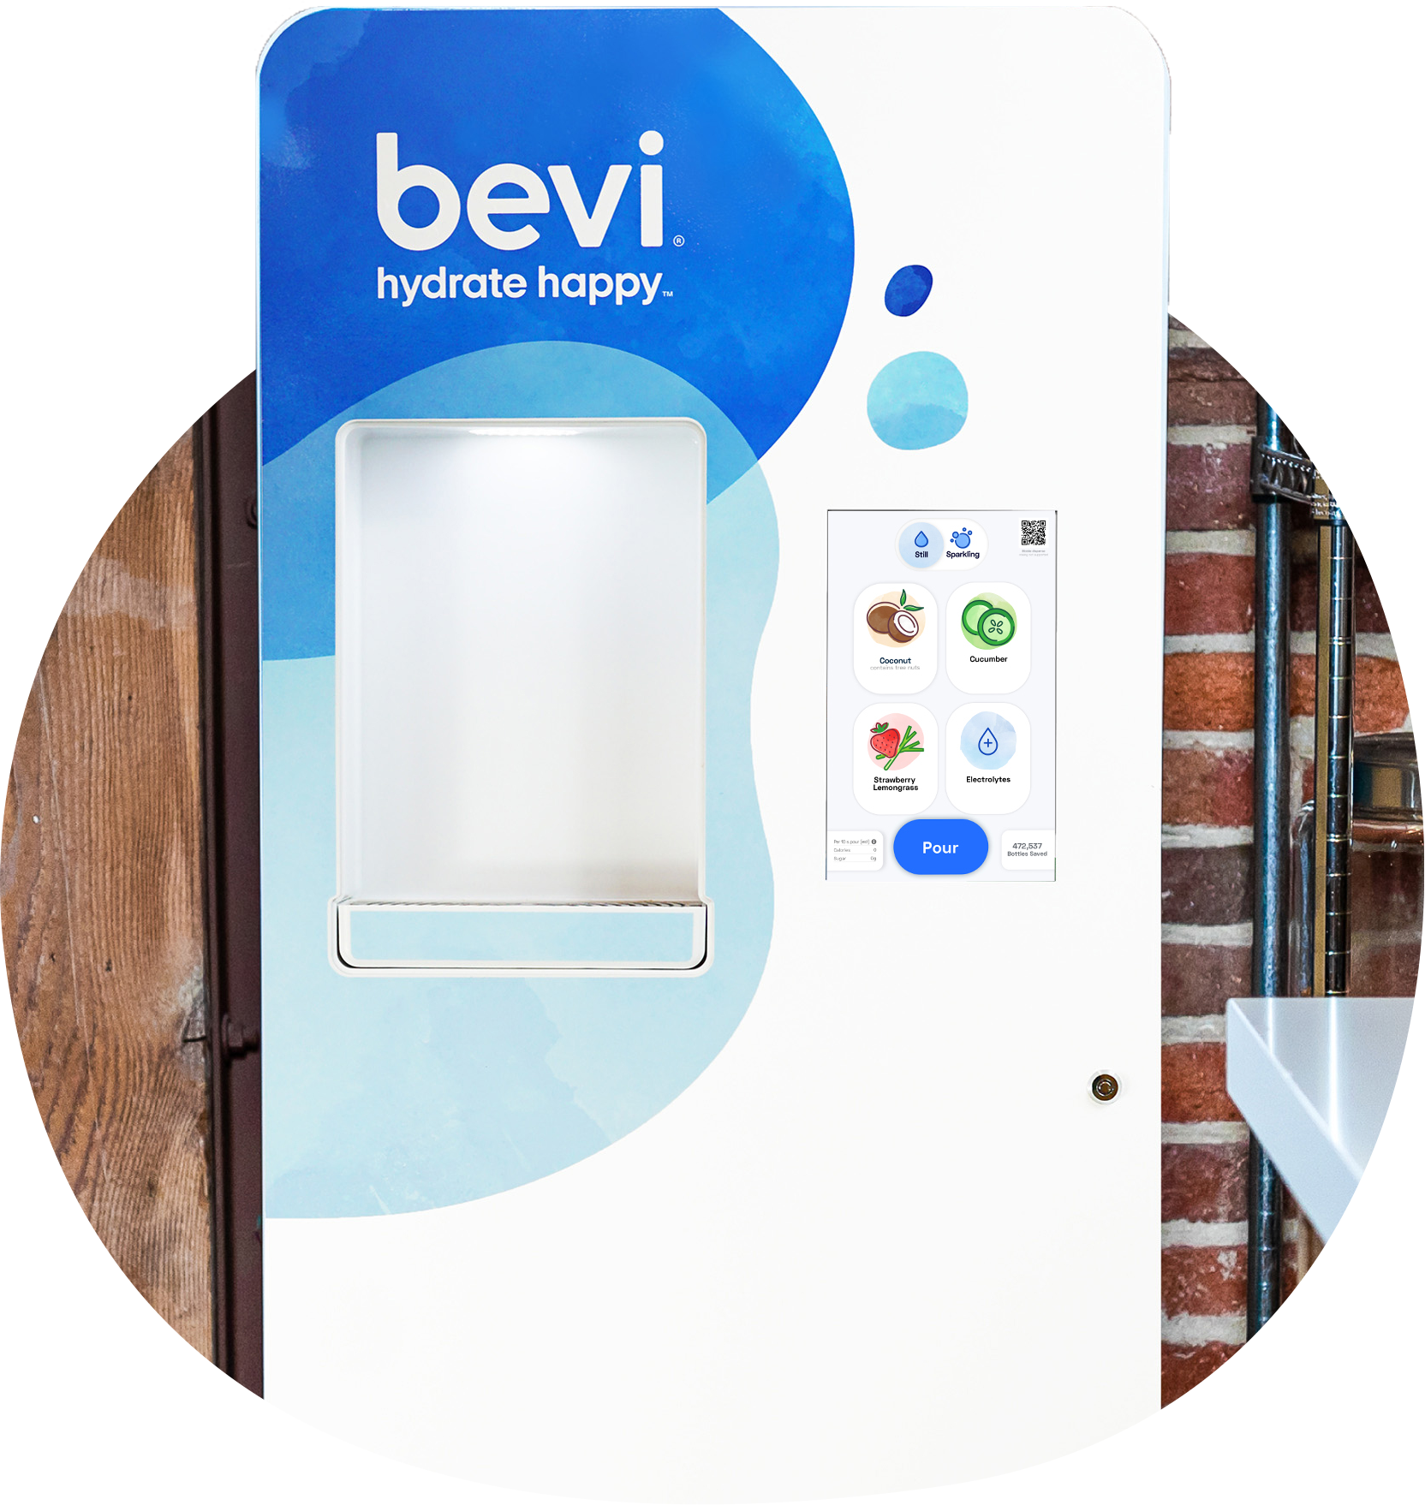
Bevi Pricing
The Countertop
The Standup 2.0
The Standup 1.5-Refurbished
Full Service
Bevi: will replace filters, CO2, and flavors/enhancements as needed.
$199
$350
$250
Partial Service
Bevi: will replace filters and CO2
Customer: will replace and order flavors/enhancements as needed
$149
$249
$149
Install and set-up fee
$500 / machine
Flavors & enhancements
$96 each
[Produces 400 12-oz. glasses of flavored water]
For your convenience, your Bevi sales representative’s contact information is below:
NAME HERE
Name:
Phone/Email:
INFO HERE
Notes:
Opener slide with logo/wordmark, title

Slide 7
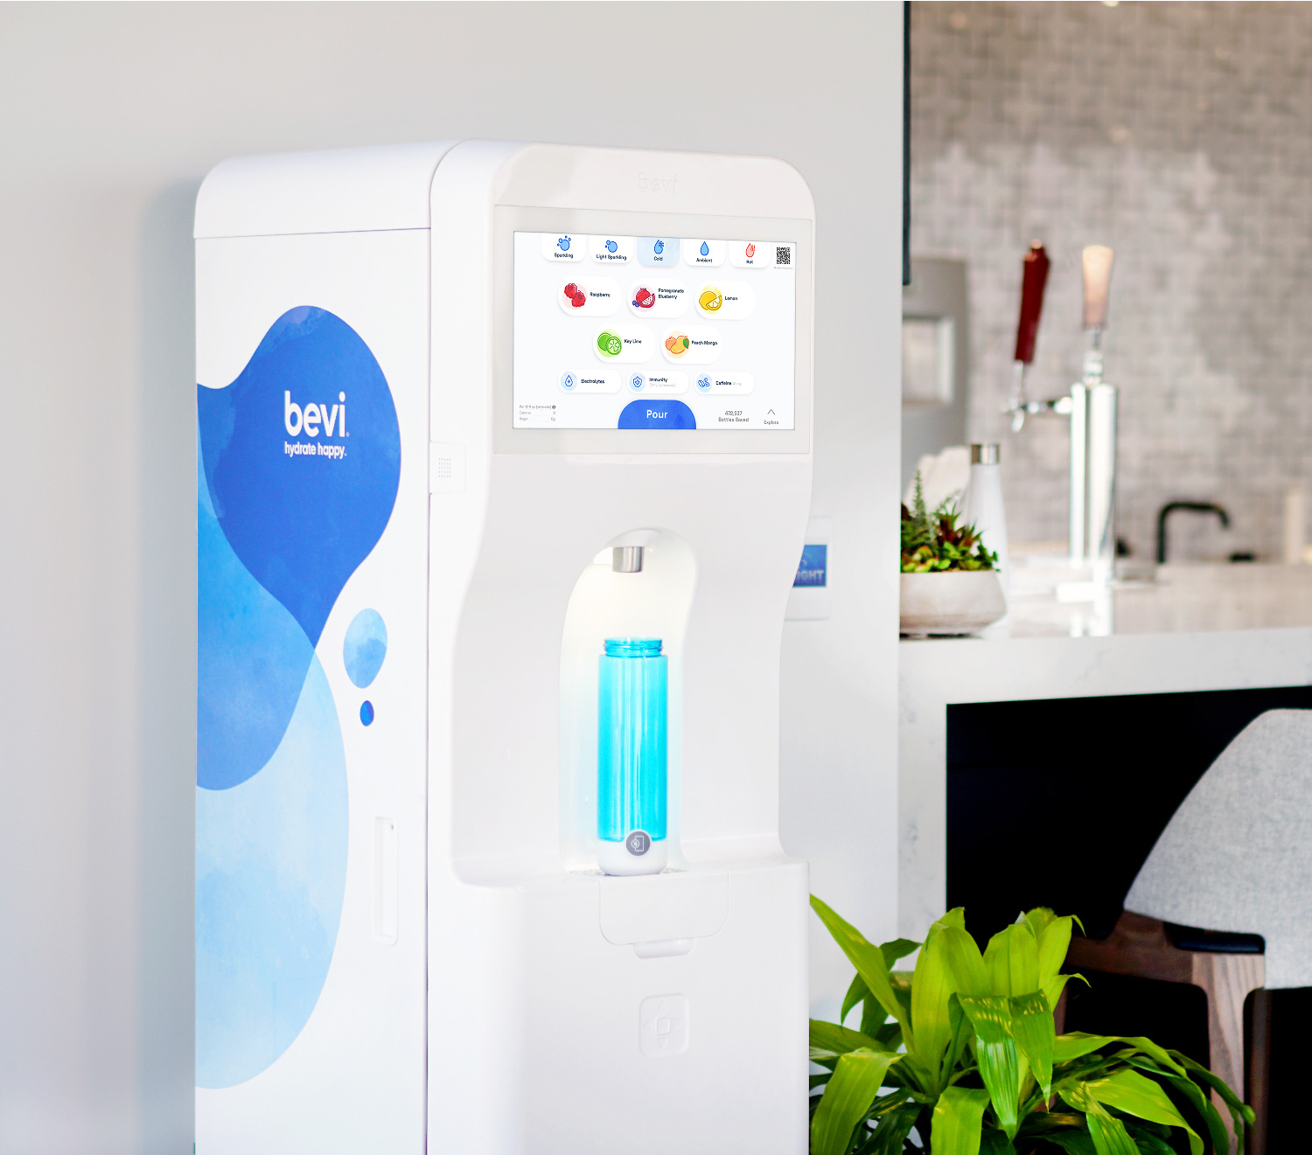
Placeholder
Image
The Standup 2.0
The Countertop
Variety & personalization, all-in-one
Still, sparkling, hot, flavored, and enhanced water options
8 flavors & enhancements—enjoy thousands of combinations
Available in classic white
Sleek, innovative design with hidden plumbing in the cabinets
Still, sparkling, flavored, and enhanced water options
4 flavors & enhancements—enjoy the most popular choices
Available in classic white and sleek black

Slide 8
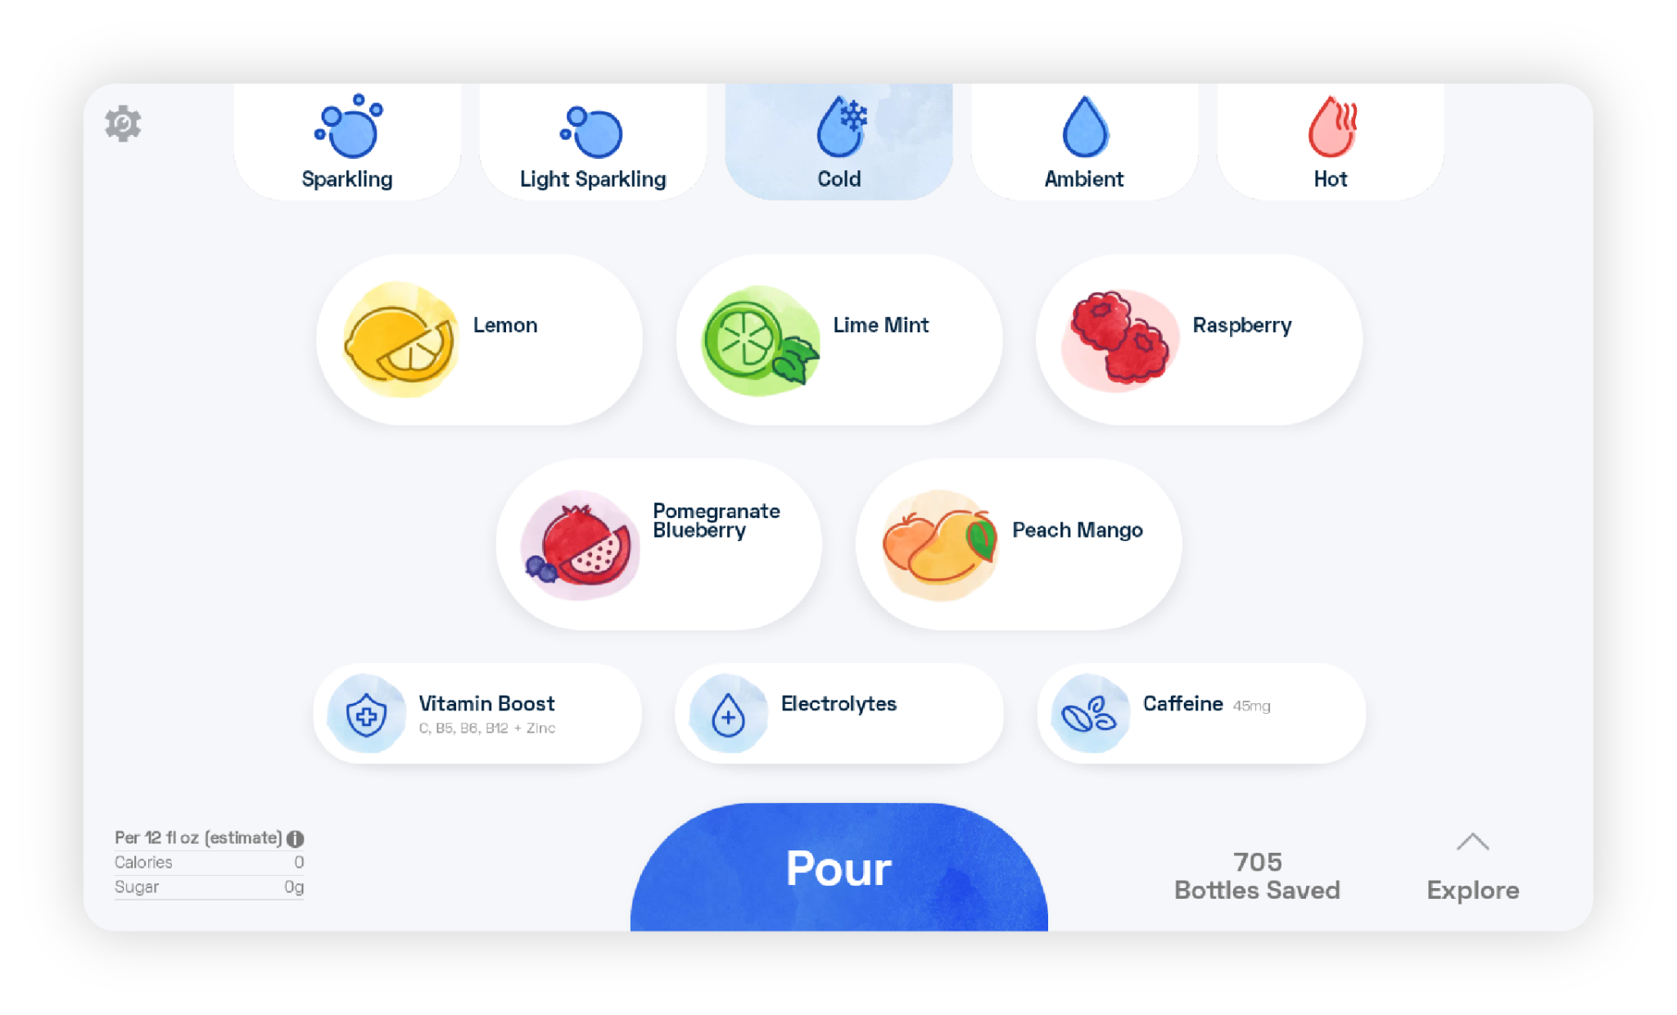
How it works:
2. Choose your temperature
Enjoy water chilled to a crisp 38 degrees. The Standup 2.0 also includes hot and ambient options, ready for any time of day or mood you’re in.
1. Choose your bubbles
All water passes through our state-of-the-art carbon filters which are designed to remove microplastics, bacteria, chlorine, and other unwanted elements from tap water.
Review Nutrition Information
Wondering what’s in your beverage? Nutrition facts are a tap away.
Learn more
See how many bottles you saved, your most popular flavors, and more.
3. Choose your flavors & enhancements
Handpick from a large variety of always natural, zero- and low-calorie flavors. Vegan, kosher certified, and free from sodium and gluten.
Notes:
Opener slide with logo/wordmark, title

Slide 9
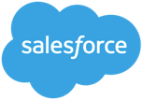
“Bevi is now in all our kitchens at Lyft HQ. Previously we stocked other flavored waters, both still and sparkling. Bevi has allowed us to lower overall beverage costs… and we have saved over 310,000 bottles!”
Matt Mohamed, Workplace Services Manager, Lyft
Notes:
Customer Showcase Template 02

