Slide 1
Benefits to commercial customers
An amenity everyone loves Water that delivers personalized flavor, well-being, and fun times in every pour.
Unbottle the future Reduce your carbon footprint–every Bevi machine can save 50,000+ bottles and cans per year. Boost wellness Quality ingredients that keep you hydrated without compromise. Cut your costs Our customers typically pay less than half the cost of canned and bottled water. Smart technology for smart hydration Keep the fun flowing without interruption with fresh on-screen content, seamless updates, and remote diagnostics.

Slide 2
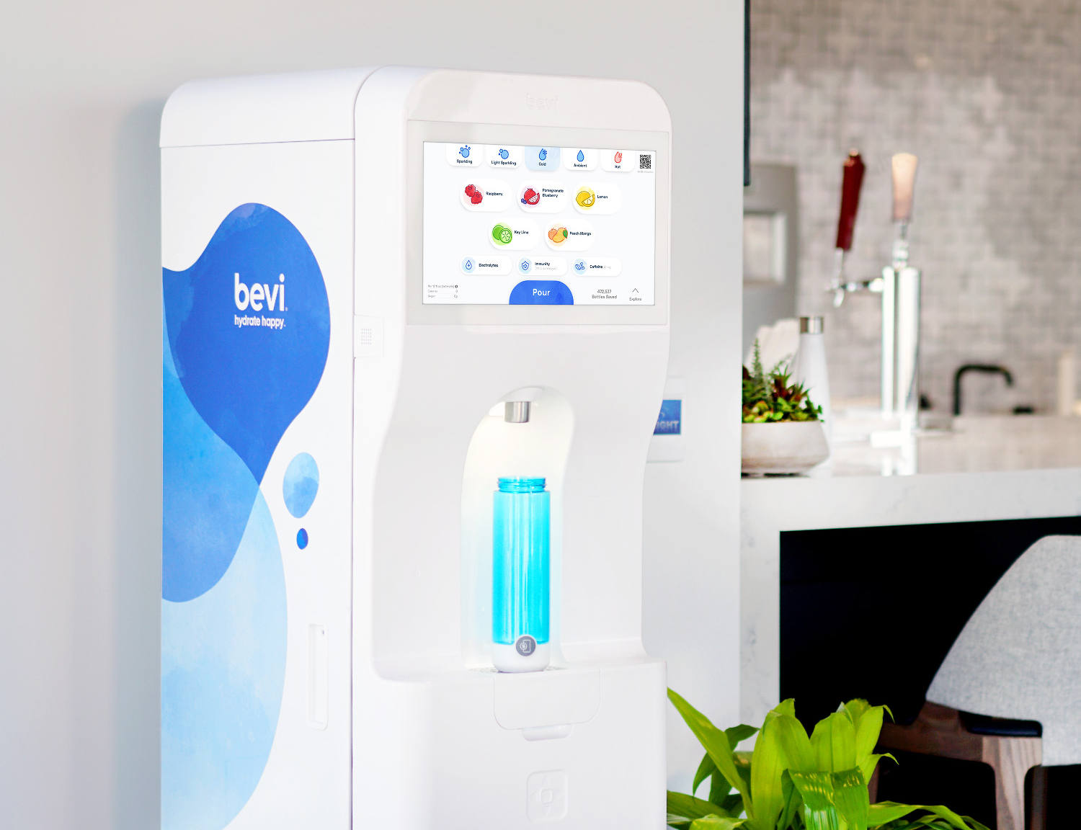
Placeholder
Image
The Standup 2.0
The Countertop
Variety & personalization, all-in-one
Still, sparkling, hot, flavored, and enhanced water options
8 flavors & enhancements—enjoy thousands of combinations
Available in classic white
Sleek, innovative design with hidden plumbing in the cabinets
Still, sparkling, flavored, and enhanced water options
4 flavors & enhancements—enjoy the most popular choices
Available in classic white and sleek black

Slide 3
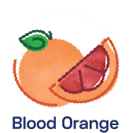
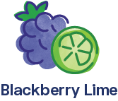
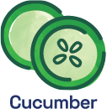
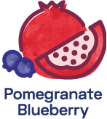
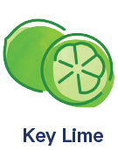
Meet Our Flavor & Enhancements
An array of flavors that are sure the make your guests smile. Choose a classic or mix flavors together for their favorite water yet.
Flavors made from real fruit essence – none of that fake stuff, ever!
Zero- and low-calorie flavors for guilt-free enjoyment
Our flavors are non-GMO, gluten-free, and vegan
Need a boost? Add an enhancement like Vitamin Boost, Caffeine, or Electrolytes.
Notes:
Opener slide with logo/wordmark, title

